Slide 1
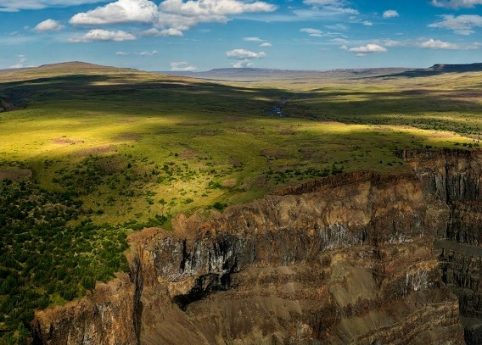
Copper-nickel type with Au, Ag and platinoids deposites
Lecture 9

Slide 2
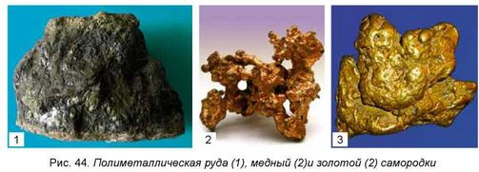
Copper-nickel type with Au, Ag and platinoids genetically differentiated with intrusive of ultramafit. Standards of world value are Bushveld in South Africa, Sadberi in Canada, Norilsk in Russian. Representative object in the Central Asian region is the deposit of Kalatong, located on Chinese territory of South-west Altai.
As the world continues to develop and advance with new technologies, the need for natural resources increases in concert. Nickel, copper, and platinum-group elements (PGEs) are but a few of the critical materials that are in demand the world over.

Slide 3
1) Layered mafic intrusion
A layered intrusion is a large sill-like body of igneous rock which exhibits vertical layering or differences in composition and texture. These intrusions can be many kilometers in area covering from around 100 km2 to over 50,000 km2 and several hundred meters to over a kilometer in thickness. While most layered intrusions are Archean to Proterozoic in age (for example, the Paleoproterozoic Bushveld complex), they may be any age such as the Cenozoic Skaergaard intrusion of east Greenland or the Rum layered intrusion in Scotland. Although most are ultramafic to mafic in composition, the Ilimaussaq intrusive complex of Greenland is an alkalic intrusion.

Slide 4
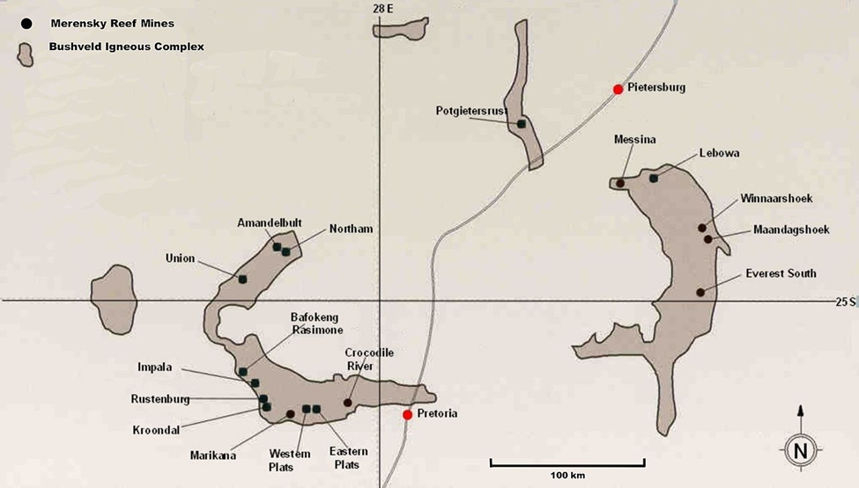
Ideally, the stratigraphic sequence of an ultramafic-mafic intrusive complex consists of ultramafic peridotites and pyroxenites with associated chromitite layers toward the base with more mafic norites, gabbros and anorthosites in the upper layers. Some include diorite, and granophyre near the top of the bodies. Orebodies of platinum group elements, chromite, magnetite, and ilmenite are often associated with these rare intrusions.

Slide 5
The Bushveld Igneous Complex
The Bushveld Igneous Complex covers a pear-shaped area in the central Transvaal. It is divided into an eastern and western lobe, with a further northern extension.
The complex varies in thickness, in places reaching 9 kilometers (5.6 mi) thick.
The orebodies within the complex include the UG2 (Upper Group 2) reef containing up to 43.5% chromite, and the platinum-bearing horizons Merensky Reef and Plat Reef. The Merensky Reef varies from 30 to 90 cm in thickness. It is a norite with extensive chromitite and sulfide layers or zones containing the ore.
The Reef contains an average of 10 ppm platinum group metals in pyrrhotite, pentlandite, and pyrite as well as in rare platinum group minerals and alloys. The Merensky and UG-2 reefs contain approximately 90% of the world's known PGM reserves. About 80% of the platinum and 20% of the palladium mined each year are produced from these horizons

Slide 6
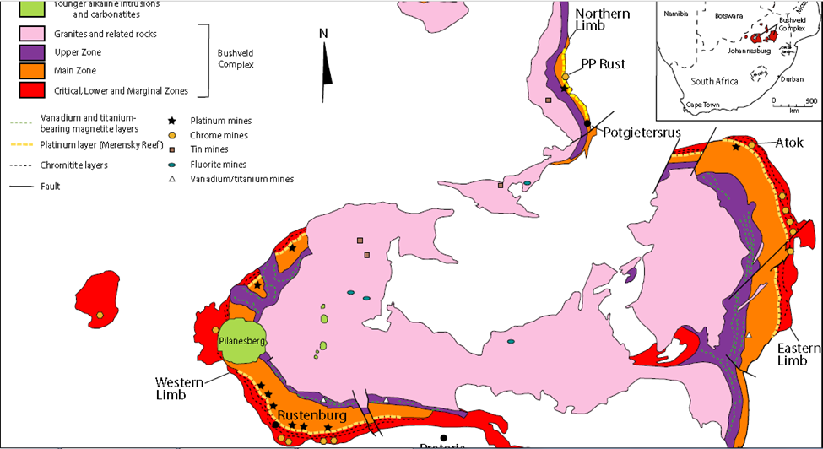
The Bushveld Igneous Complex

Slide 7
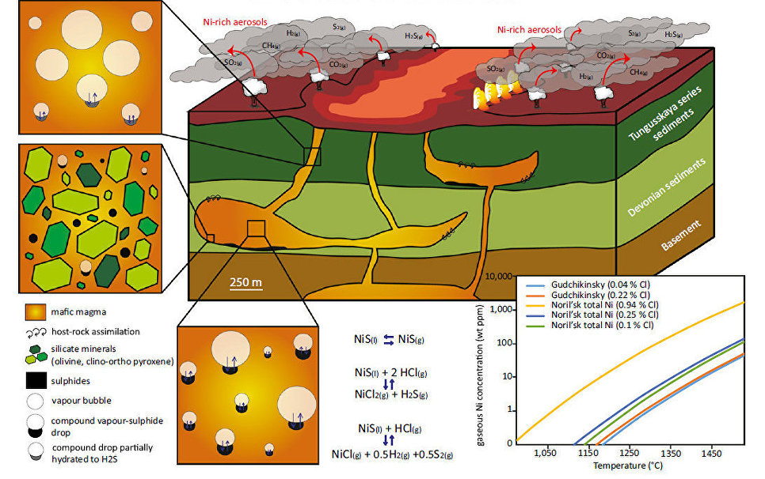

Slide 8
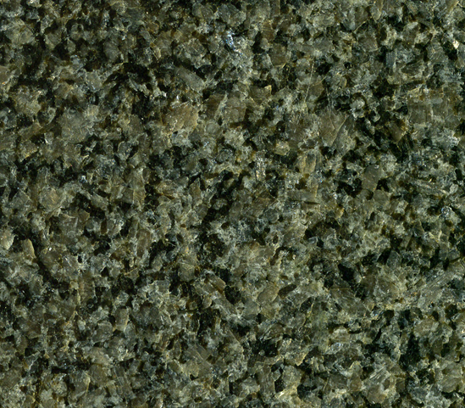
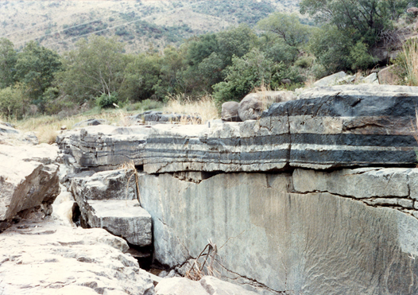
Gabbro-norites
Chromite seam in anorthosites

Slide 9
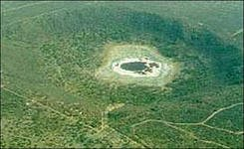
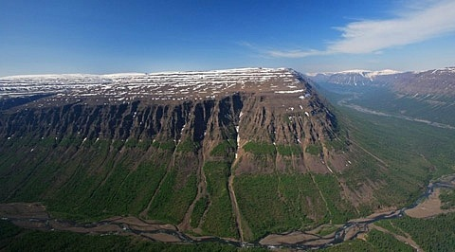
2. Mafic intrusion related to flood basalt
A flood basalt is the result of a giant volcanic eruption or series of eruptions that coats large stretches of land or the ocean floor with basalt lava. Flood basalt provinces such as the Deccan Traps of India are often called traps, after the Swedish word trappa (meaning "stairs"), due to the characteristic stairstep geomorphology of many associated landscapes. Rampino and Stothers (1988) cite eleven distinct flood basalt episodes occurring in the past 250 million years, creating large volcanic provinces, plateaus, and mountain ranges.[1] However, more have been recognized such as the large Ontong Java Plateau,[2] and the Chilcotin Group, though the latter may be linked to the Columbia River Basalt Group. Large igneous provinces have been connected to five mass extinction events, and may be associated with bolide impacts.

Slide 10
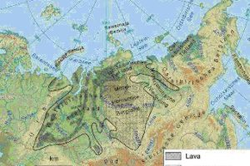

Slide 11
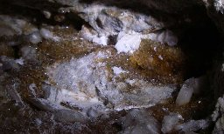
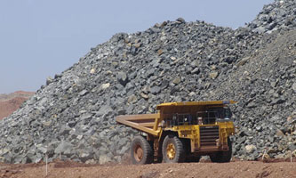
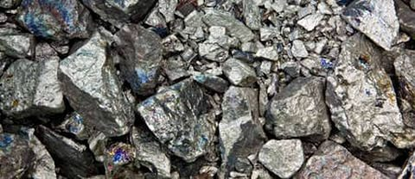

Slide 12
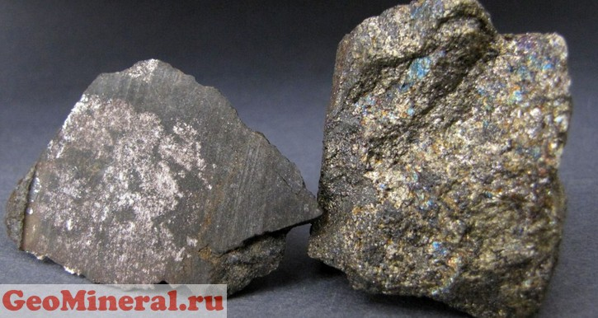
Flood basalts have tholeiite and olivine compositions (according to the classification of Yoder and Tilley). The composition of the basalts from the Paraná is fairly typical of that of flood basalts; it contains phenocrysts occupying around 25% of the volume of rock in a fine-grained matrix. These phenocrysts are pyroxenes (augite and pigeonite), plagioclases, opaque crystals such as titanium rich magnetite or ilmenite, and occasionally some olivine. Sometimes more differentiated volcanic products such as andesites, dacites and rhyodacites have been observed, but only in small quantities at the top of former magma chambers.

